Slide 1
ROAD ACCIDENT ANALYSIS
by Olabisi Olaleye

Slide 2
The Road Accident Analysis project aims to identifying patterns, trends, and contributing factors to road accidents in Nigeria for the year 2023. The goal is to gain insights into the causes of road accidents and develop strategies for accident prevention and mitigation. The dataset used for this project was gotten from the Nigeria Bureau of Statistics. The dataset contained information on Road traffic cases by state, Vehicles Involved in road accidents, Causative factors of road accident, and sex distribution of victims involved in road accident. In this analysis, I carried out an exploratory data analysis to generate insight into the contributing factors to road accidents across states, the vehicle category and type that were mostly involved in road accidents, the severity of road accidents, and the frequency of victim casualty and fatality.
INTRODUCTION

Slide 3
DATA CLEANING AND PRE-PROCESSING
The initial dataset underwent rigorous preprocessing to ensure data quality and integrity. The 2023 quarter 1 to 4 dataset for road accident downloaded was merged and sorted in excel to generate a dataset with six tables ( Road traffic cases by state, Sex distribution of road traffic crashes, Vehicle types involved in road traffic crashes, Category of vehicles involved in road accident, Causative factor, and Legend of Causative factors), that was used for the analysis of the project. The dataset was imported into Power BI for proper cleaning and exploration to handle missing values, outliers and inconsistencies. New columns were also created where needed to aid accurate analysis.

Slide 4
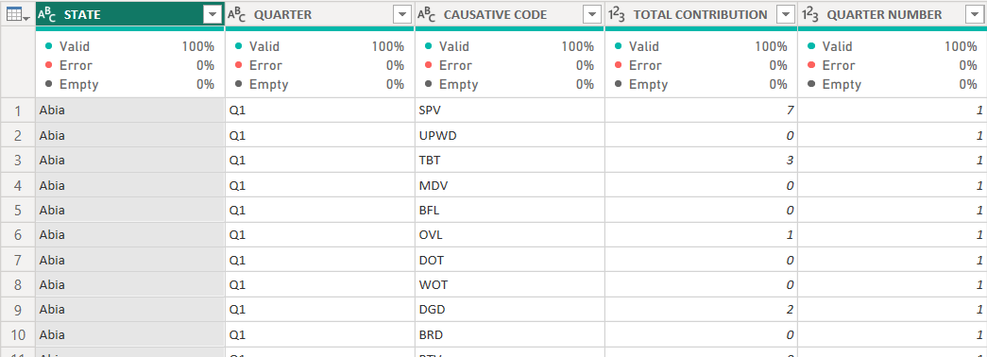
An overview of the data quality for Road accident causative factors table after cleaning

Slide 5
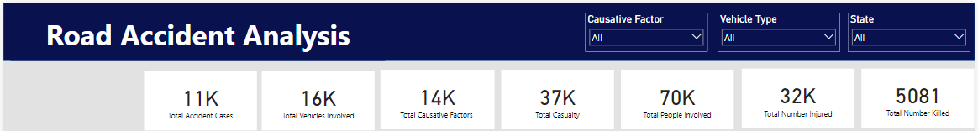
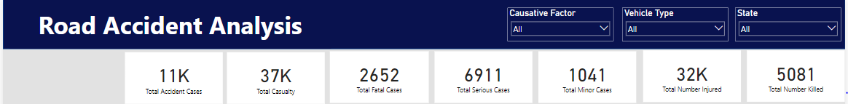
Report insight
From the analysis of the 2023 road accident dataset, the following can be deduced:
The total number of accident cases recorded for the year is 11,000 cases, with total casualties of 37,000
Total vehicles involved for all the road accident cases recorded is 16,000
Total causative factors for these road accident is 14,000
70,000 people were involved in road accident for the year, with a total of 32,000 people injured and 5,081 people killed.
The total number of fatal cases recorded is 2,652
Total number of serious cases recorded is 6,911
Total number of minor cases recorded is 1,041

Slide 6
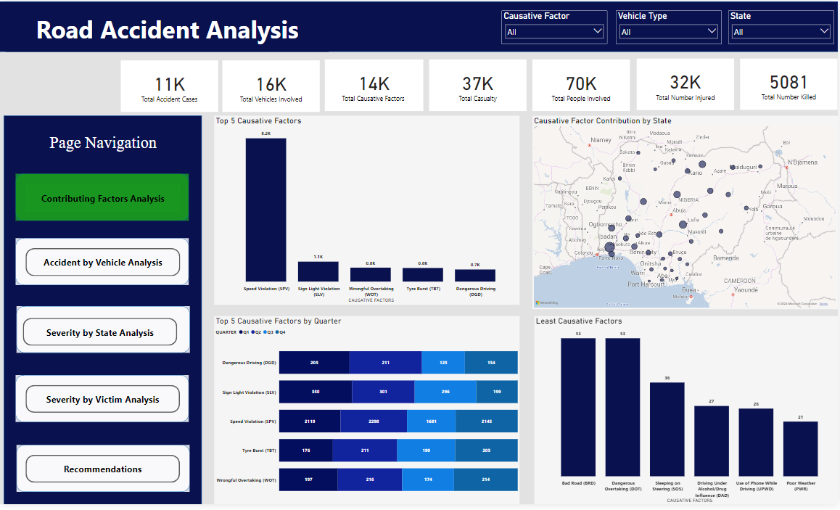
Report Insights
From the analysis of the contributing factors, it can be deduced that the top 5 causative factors of road accidents are, Speed Violation, Sign Light Violation, Wrong Overtaking, Tyre Burst, and Dangerous driving.
Speed Violation (SPV) is the highest contributing factor to road accidents with a total of 8,243 contributions while Poor Weather (PW) is the contributing factor with the least contribution to road accident with a total contribution of 21.
The State with the highest number of causative factor contribution to road accident is “FCT” with a total of 2,011 causative factor contributions, while “Bayelsa” had the lowest causative factor contribution with a total of 30 contributions.
Quarterly sum of contribution for the top 5 causative factors are Q2 with a total of 3,237, followed by Q1 with a total of 3,047, Q4 with a total of 2,917, and Q3 with a total of 2,466.

Slide 7
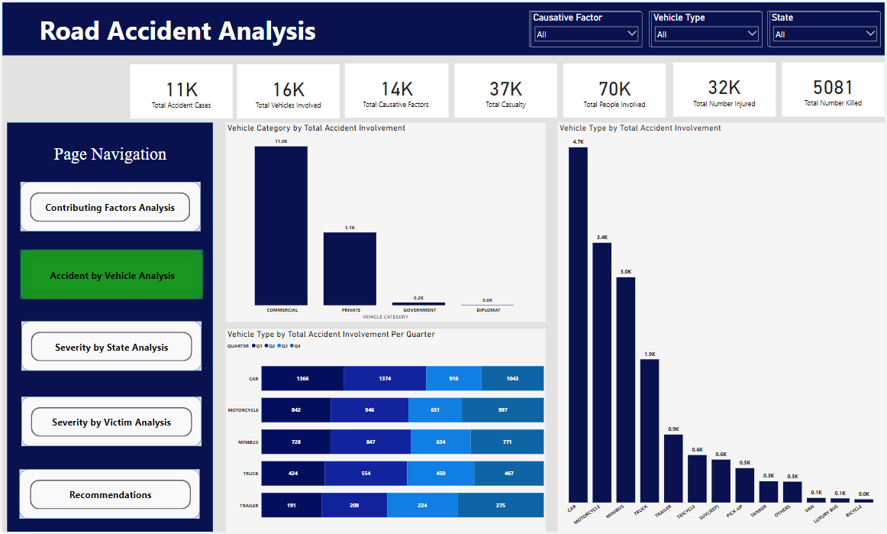
Report Insights
From the analysis of accidents by vehicles, it can be deduced that the highest category of vehicle recorded to be involved in road accident for 2023 is “Commercial vehicles” with a total of 11,024 involvements, while the least involved is “Diplomat vehicles” with a total of only 4 involvements.
The vehicle type with highest involvement in road accident for the year is “Car” with a total of 4,699 involvement, while the vehicle type with the least involvement is “Bicycle” with 43 involvements.
The vehicle type “Car” was involved in more accidents than the other vehicle types for every quarter of the year.
Quarter 2 had the highest number of vehicles involved in road accident with a total 3,930 vehicles involved in road accident for that quarter, followed by Quarter 4 with a total of 3,553, Quarter 1 with a total of 3,551, and Quarter 3 with a total of 2,875.﻿

Slide 8
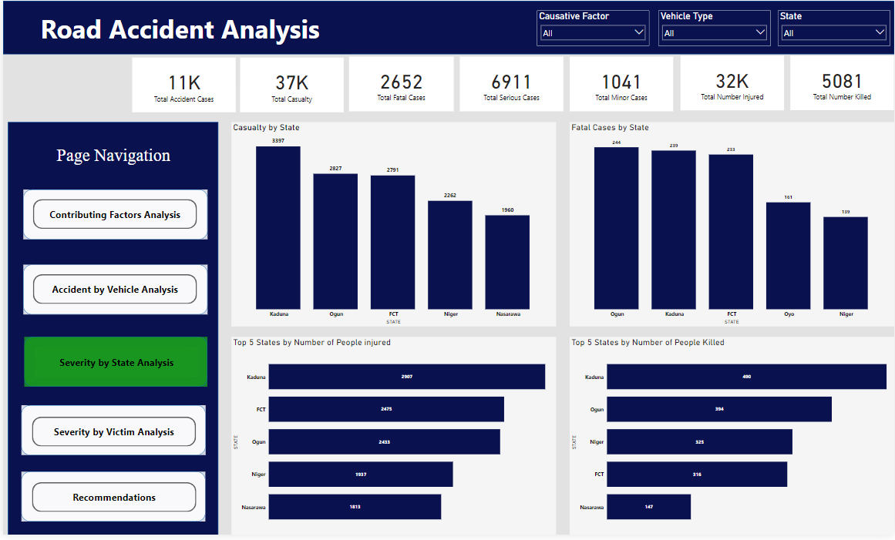
Report Insights
Analyzing accident severity by state, it can be deduced that “Kaduna” had the highest number of casualties of 3,397 recorded. With a total of 2,907 people injured, and 490 people killed.
The top 5 states with fatal cases are, Ogun with 244 cases, Kaduna with 239 cases, FCT with 233 cases, Oyo with 161 cases, and Niger with 139 cases.
Top 5 states with high amount of people injured and killed are Kaduna (2,907 injured, 490 killed), FCT (2,475 injured, 316 killed), Ogun (2,433 injured, 394 killed), Niger (1,937 injured, 325 killed), and Nasarawa (1,813 injured, 147 killed).

Slide 9
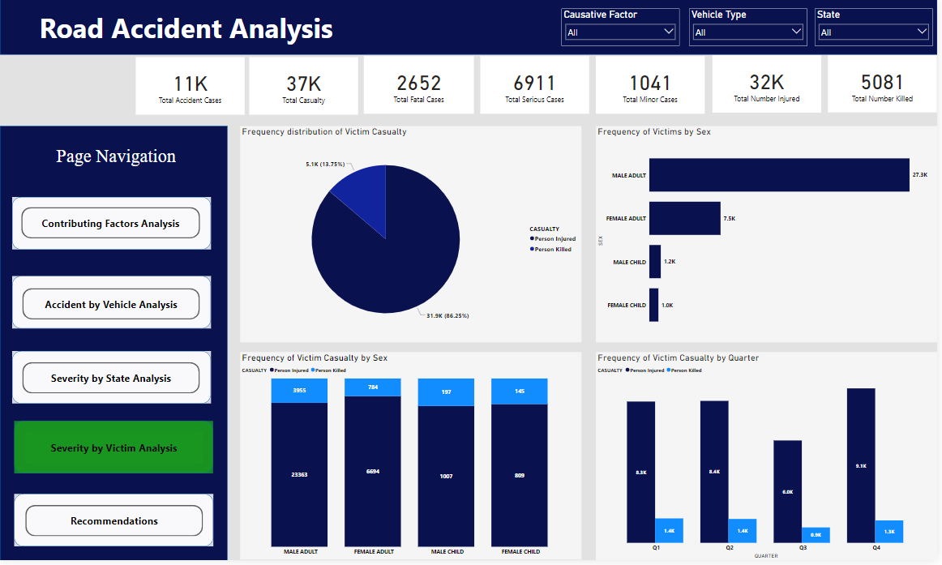
Report Insights
Analyzing accident severity by victims, it can be deduced that there were more people injured than people killed. The total number of people injured is 3,187 as compared to total number of people killed which is 5,081.
The frequency of victims involved in road accident by sex and their casualty are Male adult (23,363 injured, 3,955 killed, total 27,318), Female adult (6,694 injured, 784 killed, total 7,478), Male child (1,007 injured, 197 killed, total 1,204), Female child (809 injured, 145 killed, total 954). This shows that more male adults were involved in road accident than other sex category.
Quarter 4 had the highest number of people injured with a total of 9,116 people injured, while quarter 1 had the highest number of people killed with a total of 1,441 people killed.

Slide 10
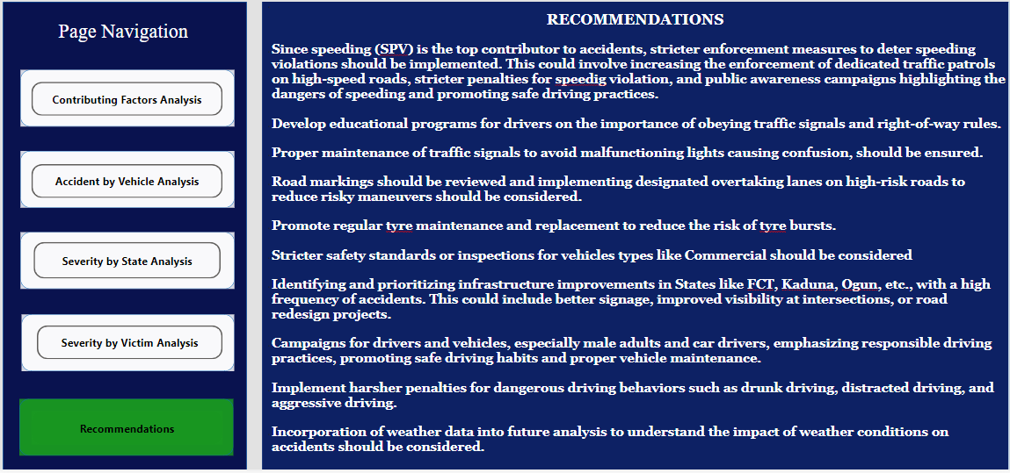
RECOMMENDATIONS

Slide 11
Click here to interact with the Report

